Slide 1
The role of the cessation of blood circulation in the determination of death
Alberto Molina Pérez
Institute for Advanced Social Studies, Spanish National Research Council

Slide 2
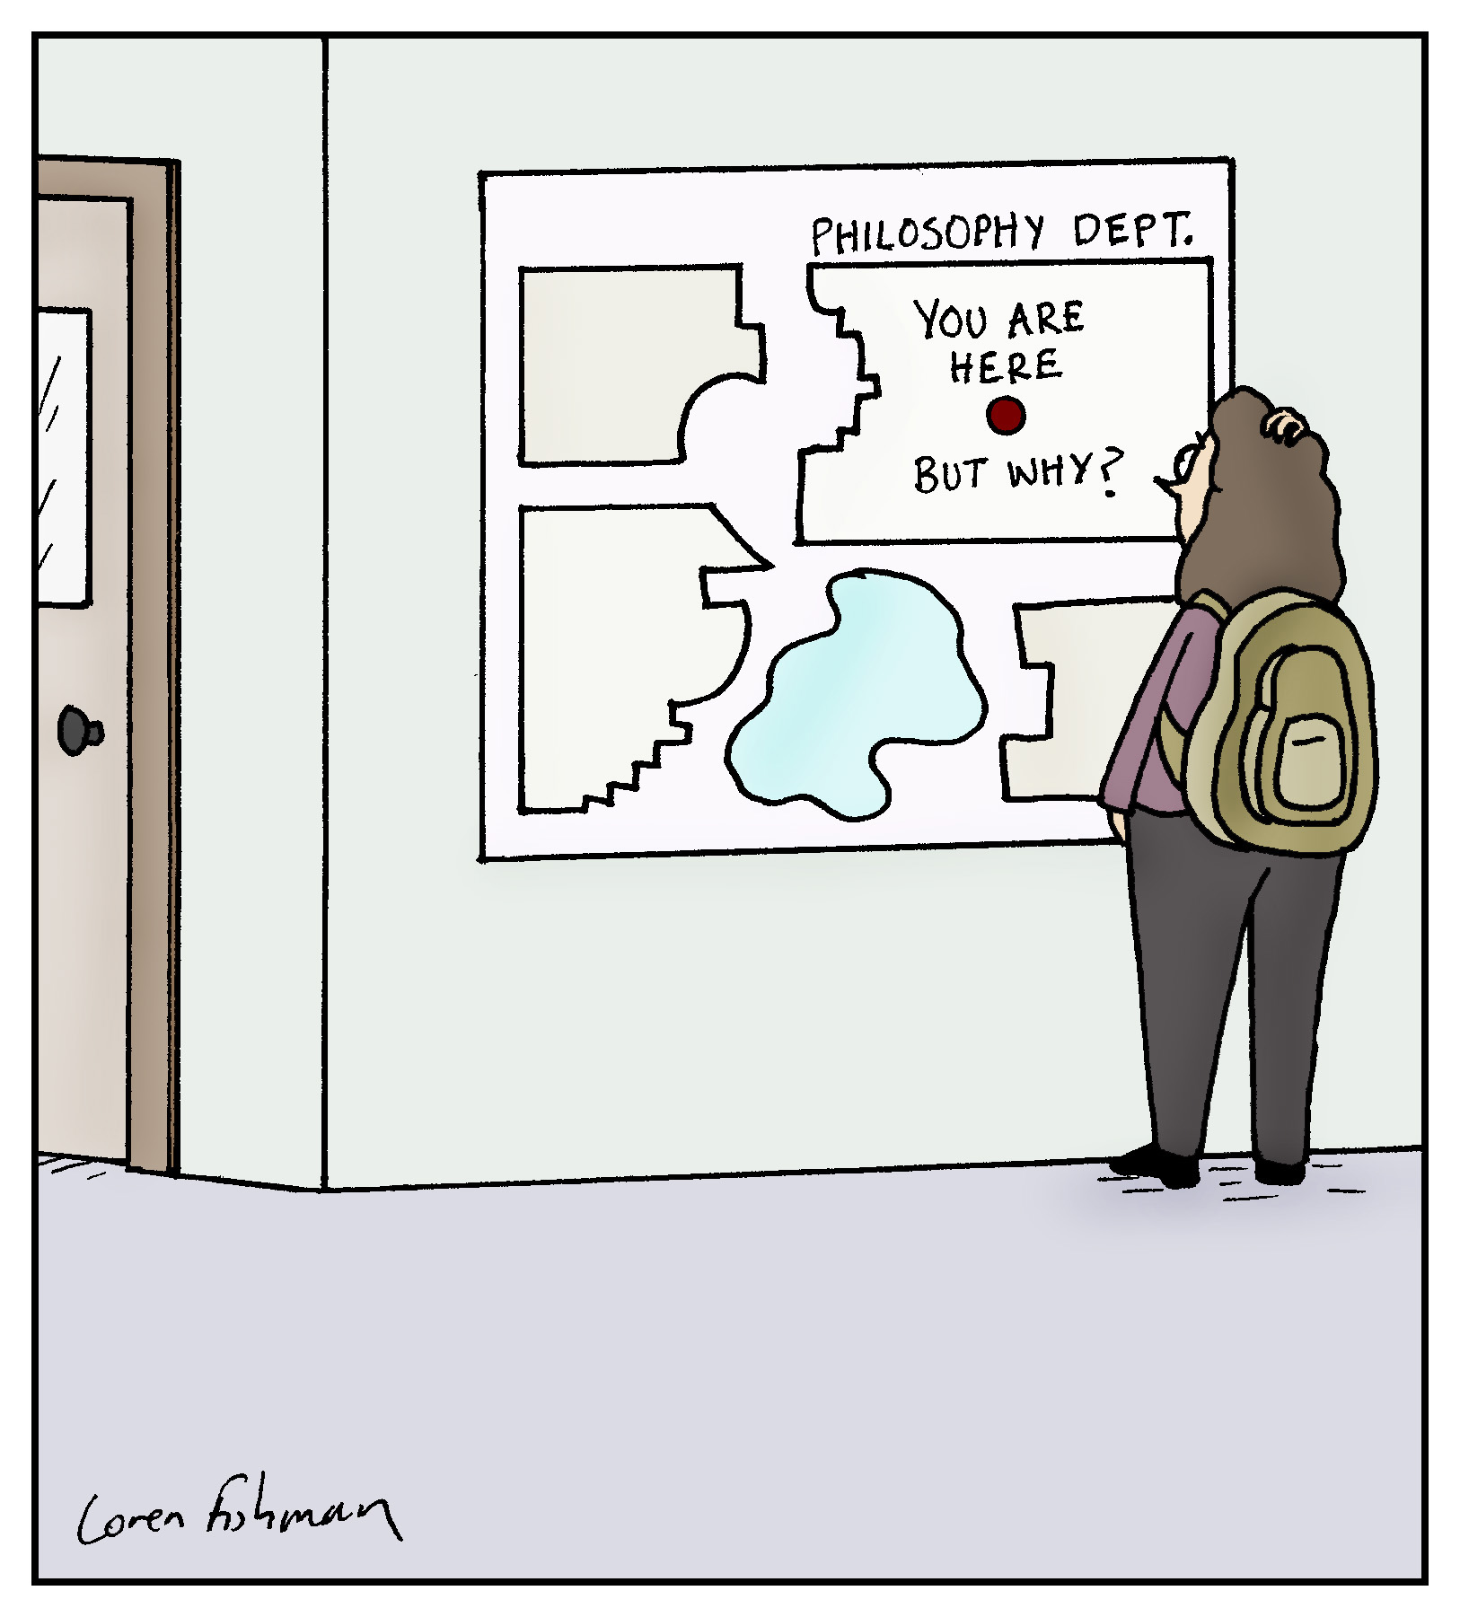
Why am I here? And you?
AMP - Circulation and death determination

Slide 3
Why am I here? And you?
Journey:
Physics
Philosophy of Physics
Philosophy of Biology
Bioethics
AMP - Circulation and death determination

Slide 4
Why am I here? And you?
Journey:
Physics
Philosophy of Physics
Philosophy of Biology
Bioethics
AMP - Circulation and death determination

Slide 5
What philosophers are good at
Asking questions (but not answering them)
Making conceptual distinctions (that actually increase your confusion)
Telling you that things are complicated (even though they initially looked simple)
AMP - Circulation and death determination

Slide 6
Now, seriously, what are we doing here?
Circulation
Death
Function
Organism as a whole
Irreversibility
We are going there
AMP - Circulation and death determination

Slide 7
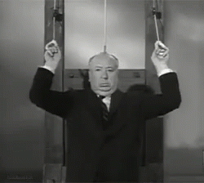
Quiz
Can we lose…
a leg
a kidney
the heart
the head
…and go on living?
AMP - Circulation and death determination

Slide 8
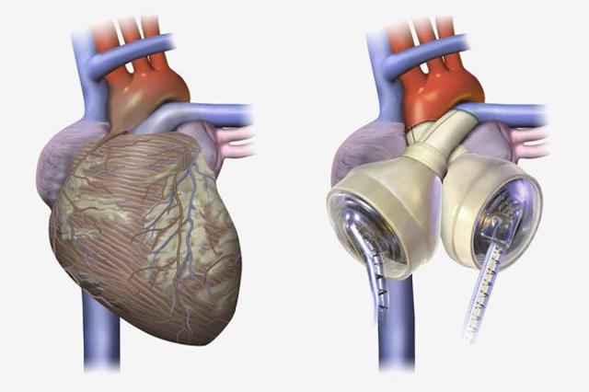
Quiz
Can we lose…
a leg
a kidney
the heart
the head
…and go on living?
AMP - Circulation and death determination

Slide 9
Quiz
Can we lose the head and go on living?
It’s complicated!
AMP - Circulation and death determination

Slide 10
From simple easy to complex complicated
— Cardiac death
— 1968
— Brain death
— 2021
AMP - Circulation and death determination

Slide 11
Cardiac death – quiz
Death occurs when the heart…
Stops
Has been stopped for some time
Cannot autoresuscitate (i.e. spontaneously start again)
B + C
Has stopped irreversibly
B + E
AMP - Circulation and death determination

Slide 12
Cardiac death – quiz
Death occurs when the heart…
Stops working
Has been stopped for some time
Cannot autoresuscitate (i.e. spontaneously start again)
B + C
Has stopped irreversibly
B + E
None of the above
AMP - Circulation and death determination

Slide 13
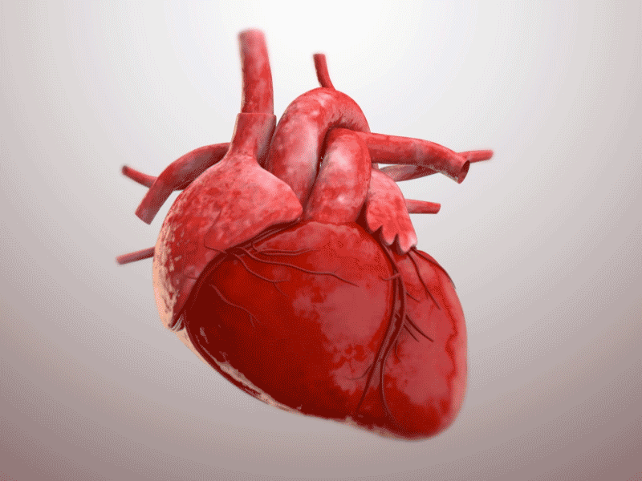
Cardiac death
What happens to the heart doesn’t matter at all
What matters is not the heart itself (i.e. the organ, the material structure) but what it does
STRUCTURE / ACTIVITY
AMP - Circulation and death determination

Slide 14
Cardiac death
Heart activities:
Consumes O₂, energy
Makes a thumping noise
Contracts
Pumps blood into the circulatory system
Etc.
AMP - Circulation and death determination

Slide 15
Cardiac death
Heart activities:
Consumes O₂, energy
Makes a thumping noise
Contracts
Pumps blood into the circulatory system
function
AMP - Circulation and death determination

Slide 16
Cardiac death
What is a function?
AMP - Circulation and death determination

Slide 17
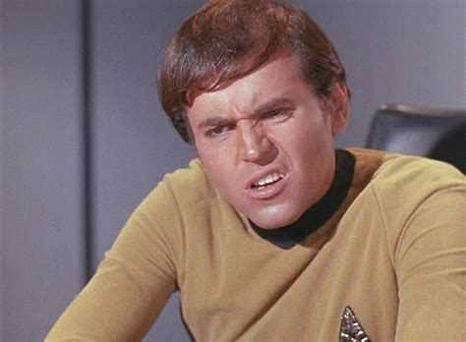
Cardiac death
What is a function?
It’s complicated!
AMP - Circulation and death determination

Slide 18
Cardiac death
What is a function?
→ One activity among others that has special relevance (for what? for whom?)
→ A means to an end
It’s problematic!
AMP - Circulation and death determination

Slide 19
Cardiac death
Death occurs when the circulatory function has been (irreversibly) stopped (for some time)
AMP - Circulation and death determination

Slide 20
Cardiac death
Death occurs when the circulatory function has been (irreversibly) stopped (for some time)
For how long? (We don’t know)
What does “irreversible” mean? We/it cannot be restored totally/at all
What is the function of blood circulation?
AMP - Circulation and death determination

Slide 21
Cardiac death
Death occurs when the circulatory function has been (irreversibly) stopped (for some time)
For how long? (We don’t know)
What does “irreversible” mean? We/it cannot be restored totally/at all
What is the function of blood circulation?
→ gases (O₂, CO₂)
→ nutrients / waste
→ other (fluids…)
Necessary for the functioning of cells
AMP - Circulation and death determination

Slide 22
Cardiac death
Death occurs when the circulatory function has been (irreversibly) stopped (for some time)
For how long? (We don’t know)
What does “irreversible” mean? We/it cannot be restored totally/at all
What is the function of blood circulation?
→ gases (O₂, CO₂)
→ nutrients / waste
→ other (fluids…)
Necessary for the functioning of cells
A means to an end
AMP - Circulation and death determination

Slide 23
Cardiac death
Cessation of circulation causes the death of cells, which are the building blocks of the organism
→ Death is when all body cells die (whole organism)
→ Death is the cessation of functioning of the organism as a whole
AMP - Circulation and death determination

Slide 24
Cardiac death
What does the organism as a whole mean?
AMP - Circulation and death determination

Slide 25
Cardiac death
What does the organism as a whole mean?
It’s complicated!
AMP - Circulation and death determination

Slide 26
Cardiac death
What does the organism as a whole mean?
It’s complicated!
I don’t know
AMP - Circulation and death determination

Slide 27
Cardiac death
What does the organism as a whole mean?
It’s complicated!
I don’t know
A self-sustained network of functions
AMP - Circulation and death determination

Slide 28
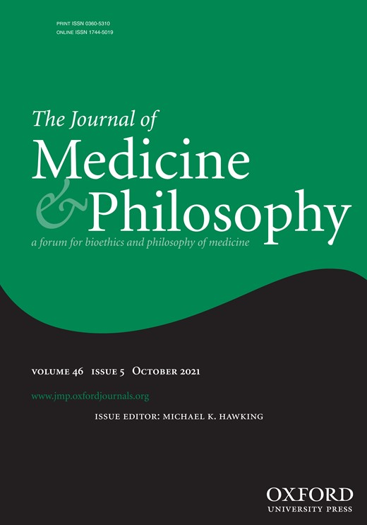
Cardiac death
What does the organism as a whole mean?
AMP - Circulation and death determination

Slide 29
Cardiac death
When are we not dead?
As long as the heart spontaneously pumps blood
As long as the heart can spontaneously start again
As long as the heart’s function can be artificially restored (CPR)
As long as the circulatory function is performed (either spontaneously or artificially)
AMP - Circulation and death determination

Slide 30
1968
AMP - Circulation and death determination

Slide 31
1968
1959 – Wertheimer, Jouvet & Descortes: “Death of the nervous system” syndrom
1959 – Mollaret & Goulon: “Coma dépassé”
1965 – Guy Alexandre: kidney procurement from a patient in “coma dépassé” (legally alive)
1966 – Conseil national de l'Ordre des médecins: coma dépassé = death
1968 – WMA Declaration of Sydney
1968 – Ad Hoc committee of the Harvard Medical School
AMP - Circulation and death determination

Slide 32
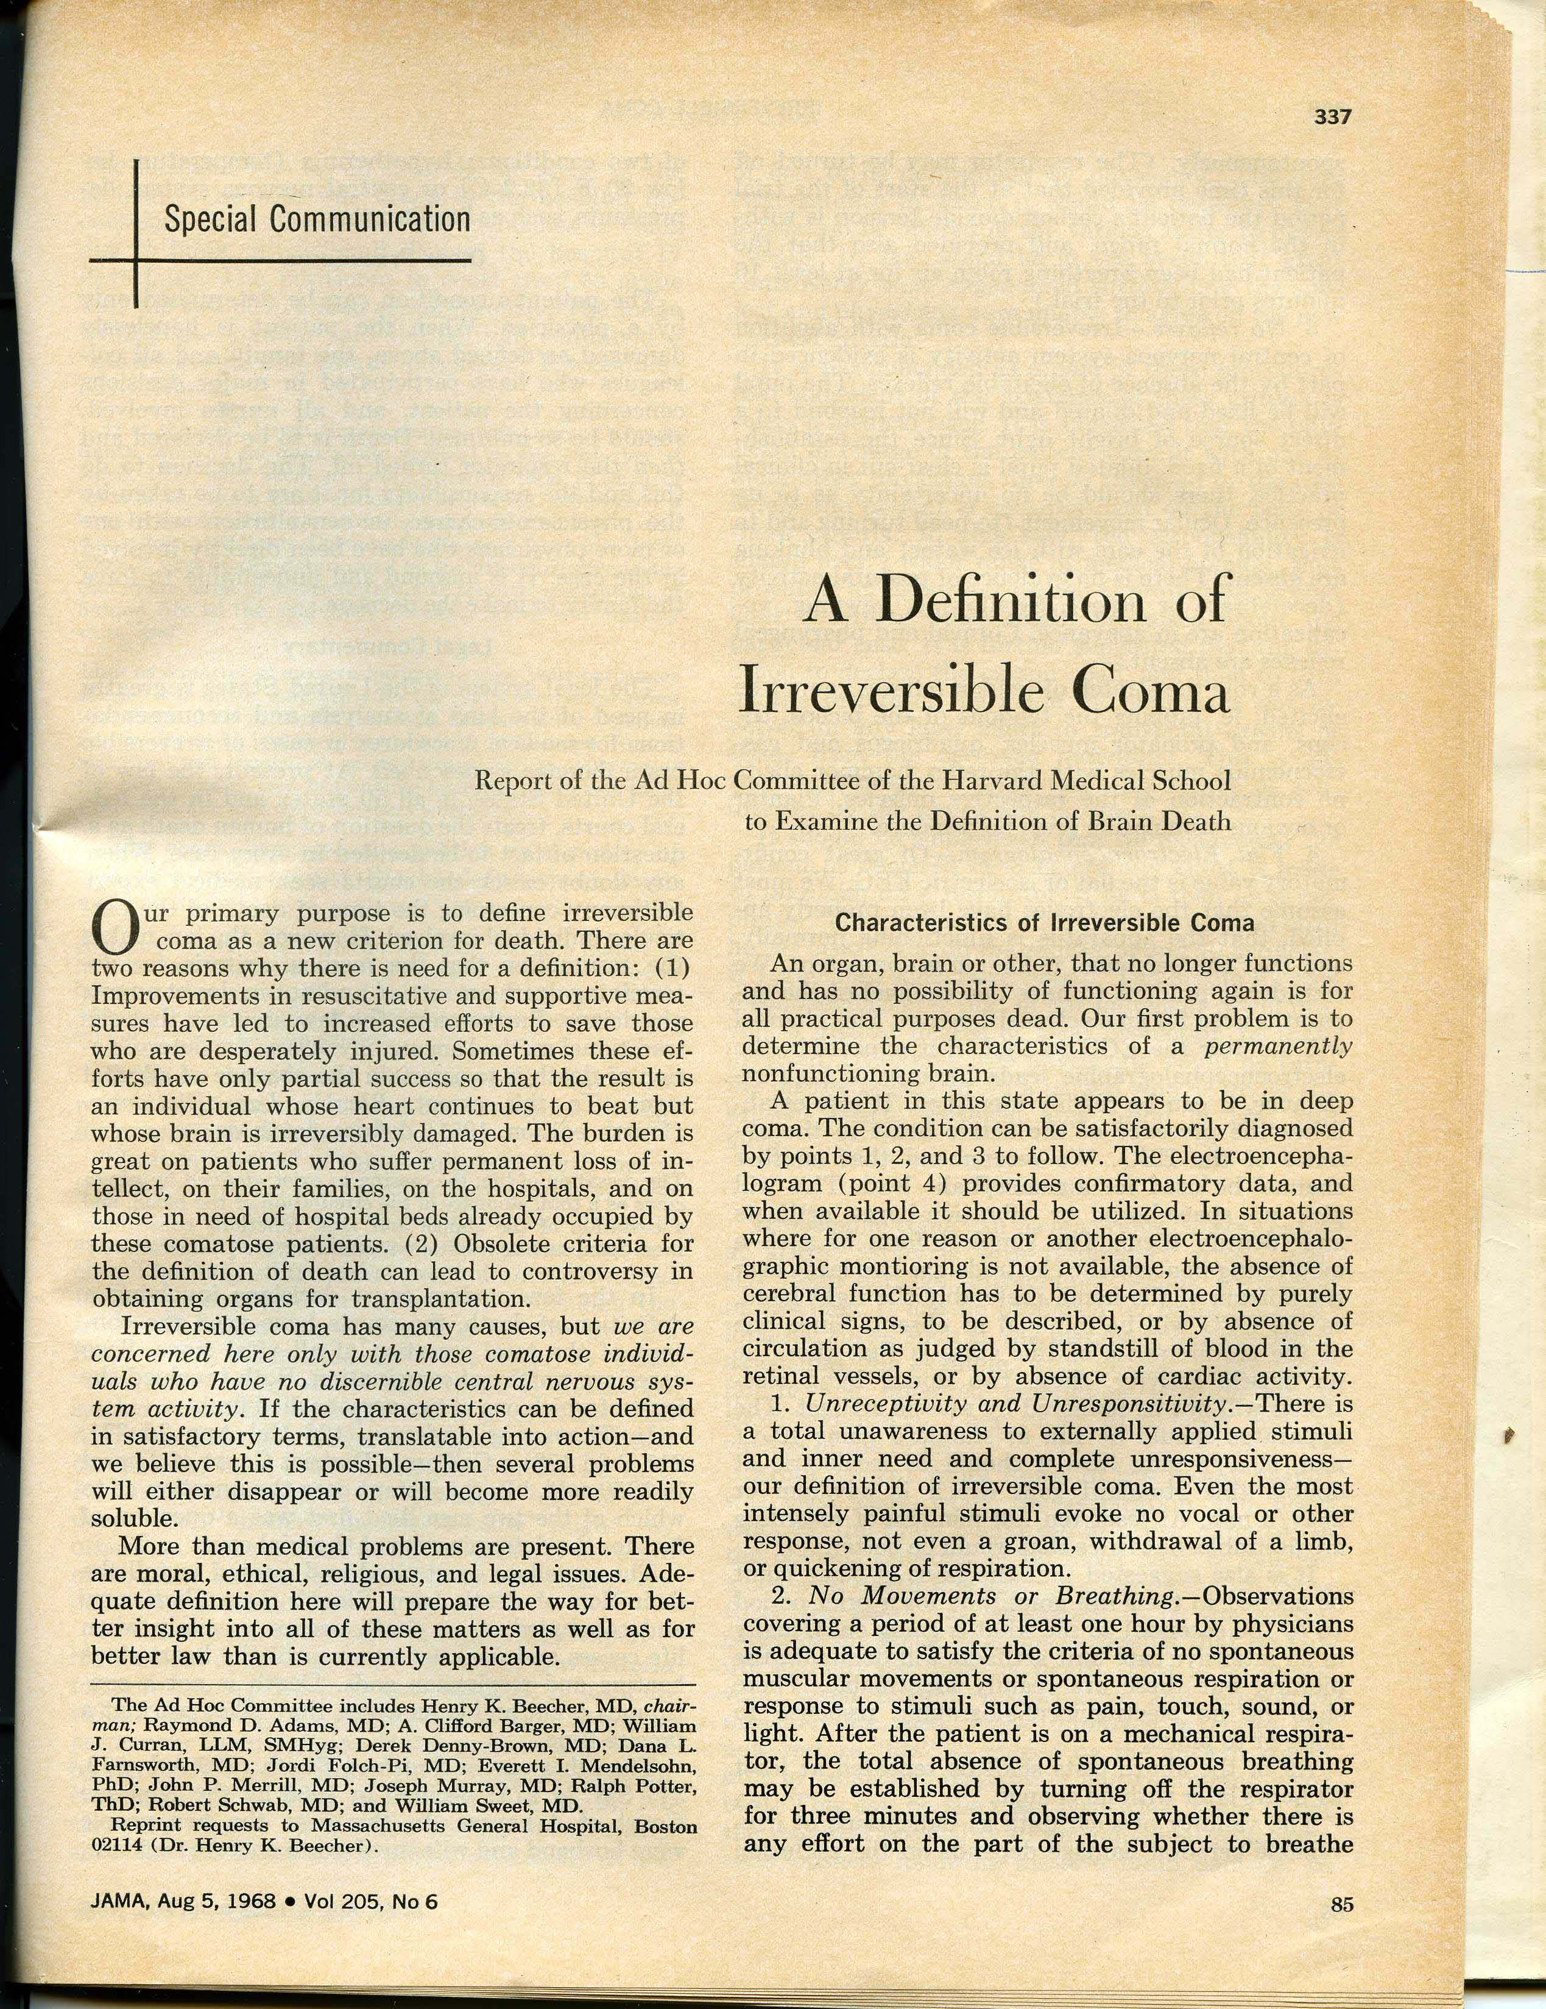
1968
Harvard’s justification:
Burden on patients, families, hospitals, and those in need of hospital beds
Controversy in obtaining organs for transplantation
AMP - Circulation and death determination

Slide 33
1968
Harvard’s justification:
Burden on patients, families, hospitals, and those in need of hospital beds
Controversy in obtaining organs for transplantation
No scientific justification for the claim that brain death = death but practical, moral, and legal
AMP - Circulation and death determination

Slide 34
Brain death
AMP - Circulation and death determination

Slide 35
Brain death
President’s Commission, 1981
*Uniform Death Determination Act
Irreversible cessation of circulatory and respiratory functions
Irreversible cessation of all functions of the entire brain
AMP - Circulation and death determination

Slide 36
Brain death
President’s Commission, 1981
*Uniform Death Determination Act
Irreversible cessation of circulatory and respiratory functions
Irreversible cessation of all functions of the entire brain
*First philosophical & scientific justification
Bernat, Culver, Gert 1981: “Whole-brain death” theory
AMP - Circulation and death determination

Slide 37
Brain death
“Whole-brain death = death” theory
All living beings are integrated systems (i.e. they function as a whole)
The brain is necessary for the functioning of the organism as a whole
Initiation of respiration
Thermoregulation
Blood pressure regulation (anti-diuretic hormone)
Etc. → The brain acts as an orchestra director for the rest of the body
If the brain is not functioning, the organism is not integrated
AMP - Circulation and death determination

Slide 38
Brain death
“Whole-brain death = death” theory
Evidence of disintegration of brain dead patients’ organism
AMP - Circulation and death determination

Slide 39
Brain death
“Whole-brain death = death” theory
Evidence of disintegration of brain dead patients’ organism
Not all brain functions are integrative Not all integrative functions are in the brain
Self-fulfilling profecy
Stabilized patients (Japan; New Jersey)
Persisting brain functions (hormonal)
AMP - Circulation and death determination

Slide 40
Brain death
Ongoing controversy (circulation)
False positives (remaining blood flow)
AMP - Circulation and death determination

Slide 41
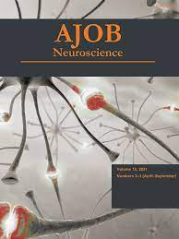
Brain death
Ongoing controversy (circulation)
False positives (remaining blood flow)
AMP - Circulation and death determination

Slide 42
Brain death
Ongoing controversy (circulation)
False positives (remaining blood flow)
DCDD + ECMO → brain circulation → brain functions?
DBDD: irreversibility of brain death (pigs brains)
AMP - Circulation and death determination

Slide 43
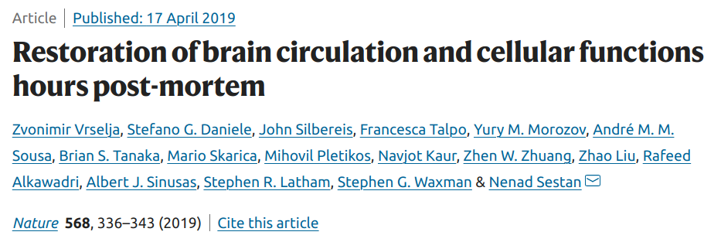
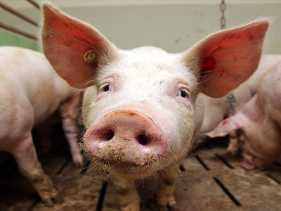
Brain death
Ongoing controversy (circulation)
False positives (remaining blood flow)
DCDD + ECMO → brain circulation → brain functions?
DBDD: irreversibility of brain death (pigs brains)
AMP - Circulation and death determination

Slide 44
Brain death
Can we lose the head and go on living?
AMP - Circulation and death determination

Slide 45
Brain death
Can we lose the head body and go on living?
AMP - Circulation and death determination

Slide 46
Brain death
Can we lose the head body and go on living?
In 1940s, Russian scientists kept a dog’s head alive for a few hours.
AMP - Circulation and death determination

Slide 47
Brain death
Ongoing controversy (circulation related)
False positives (remaining blood flow)
DCDD + ECMO → brain circulation → brain functions?
DBDD: irreversibility of brain death (pigs brains)
DCDD: irreversibility of cardiac death (5 min)
AMP - Circulation and death determination

Slide 48
2021
AMP - Circulation and death determination

Slide 49
2021
A. Molina-Pérez, J. Bernat, A. Dalle Ave (forthcoming)
– Death of the whole-brain death
– UDDA conceptual inconsistencies
– No good solutions
AMP - Circulation and death determination

Slide 50
2021
New definition proposals
US Government’s subcommission
AMP - Circulation and death determination

Slide 51
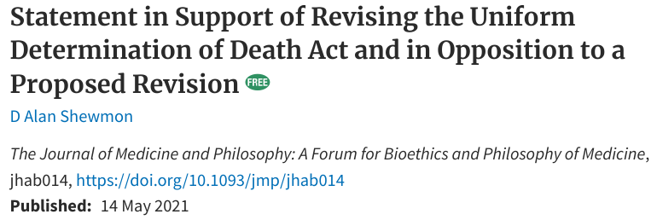
2021
New definition proposals
US Government’s subcommission
Shewmon’s statement
AMP - Circulation and death determination

Slide 52
Thank you!
AMP - Circulation and death determination

