Slide 1
The social utility of naturalistic knowledge from action research for social impact in Latin America
99. Emerging Researchers' Group (for presentation at Emerging Researchers' Conference) 26 - 27 August 2024 EERA European Educational Research Association, 27 - 30 August 2024 University of Cyprus Jiménez-León, Rodolfo; Cisneros-Chacón, Edith; Moral-Santaella, María Cristina; and Magaña-Medina, Deneb Elí.
The social utility of naturalistic knowledge from action-research for social impact in Latin America © Year 2024 by is under license CC BY-NC 4.0
Mobility Scholarship Program: CUMex – AUIP 2024

Slide 2
Problematic
Education Administration
User
Utilidad social del conocimiento
Relación ciencia-sociedad
Relevancia social
Liderazgo pedagógico
It represents a complex and multidimensional social phenomenon: it involves a series of situated and far-reaching processes that involve several dimensions (material, symbolic, cognitive, political, epistemological, etc.) and is composed of a set of differential relationships between different elements (artifacts, individual agents, senses/significations, groups, collectives, institutions, etc.).

Slide 3
Problematic
Science
Technology
Political education
Educational administration
It is necessary to transform the organizations in which the educational experience is lived, science is generated, and technology is produced. Without quality education for all, it would be impossible to cultivate scientific and technological vocations to train new researchers.
Organizational transformation, education, science and technology therefore delimit the minimum pyramid base on which the development we seek can be based. Of these four basic factors, the most important one that we can most directly affect is education. The mission proposes to immediately focus on its transformation.

Slide 4
Through the social utility of knowledge, it is necessary to ask how it should be addressed from the didactic situation, so the questions are established:
What is the purpose of scientific knowledge and for whom is it beneficial?
What relationships are promoted between teachers and students according to the different interpretations of the usefulness of knowledge?
Who plays a role in defining the social utility of knowledge for social justice?

Slide 5
Research objective
Redefining research problems by identifying social inclusion issues and trying to resolve them: “academic research can make a contribution directly aimed at helping to solve social inclusion problems, beyond the indirect contributions it may eventually make through economic development and its subsequent distribution” (Alzugaray et al., 2011).
Interpretive flexibility: meaning of use (including symbolic) of the artifact by the different relevant social groups (Vaccarezza & Zabala, 2002: 35).

Slide 6
Methodology
Qualitative research
Case study
a) the central principle of the search for understanding
b) the norm of the proximity of the researcher to the object;
.
c) the emphasis on the inductive work of the reality investigated
d) the recognition of the evaluative context of the research
Narratives, photographs, visual and sound elements
Contents based on:
Active and agile methodologies
Action-participation research
Social utility of knowledge
Social relevance Knowledge-Society relationship
Educational intervencion with teacher
The general methodological strategy is qualitative, oriented towards empirical exploration and conceptual generation. It is assumed that qualitative research is characterized by its four principles (Crowson, 1998).
are intelligible in their specificity. Understanding involves capturing the meaning that people attribute to discourses and actions, as well as the dialectical and historical framework that gives meaning to these actions. It includes the interpretation of the actors' frame of reference and their inclusion in the socio-historical-political context.

Slide 7
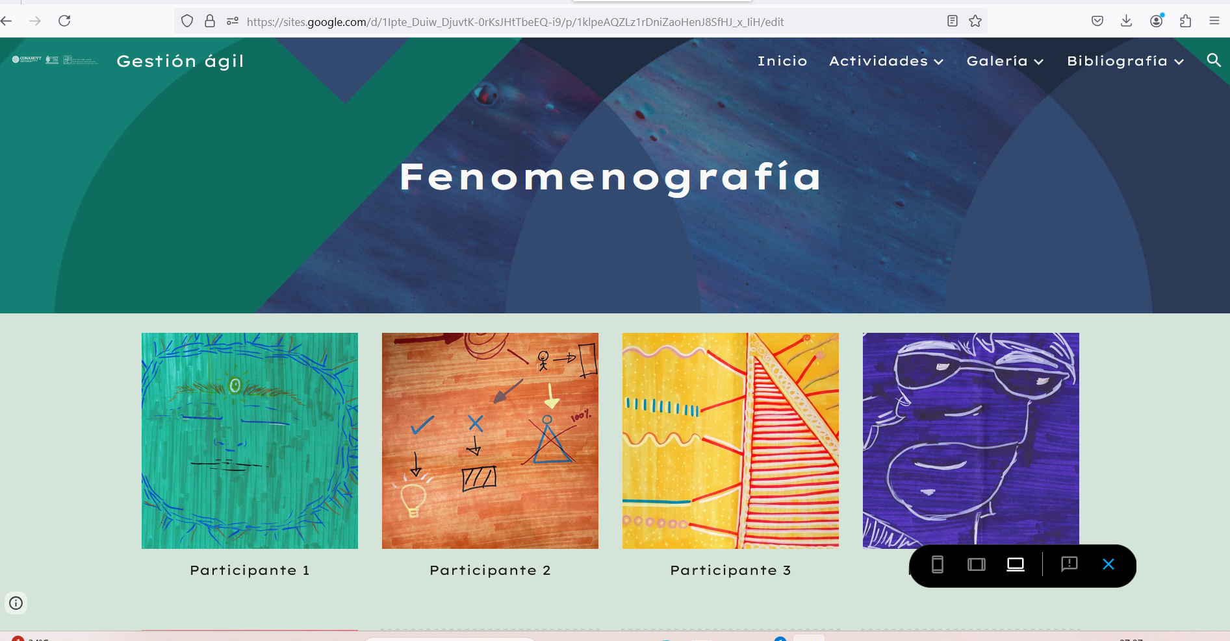
Case study: “Agile management in educational projects with qualitative methods”
1
[1].- Jiménez-León, R. & Cisneros-Chacón, E. J. (2023). Expo 2024 colectiva: Gestión ágil para proyectos educativos con métodos cualitativos. Universidad Autónoma de Yucatán.

Slide 8
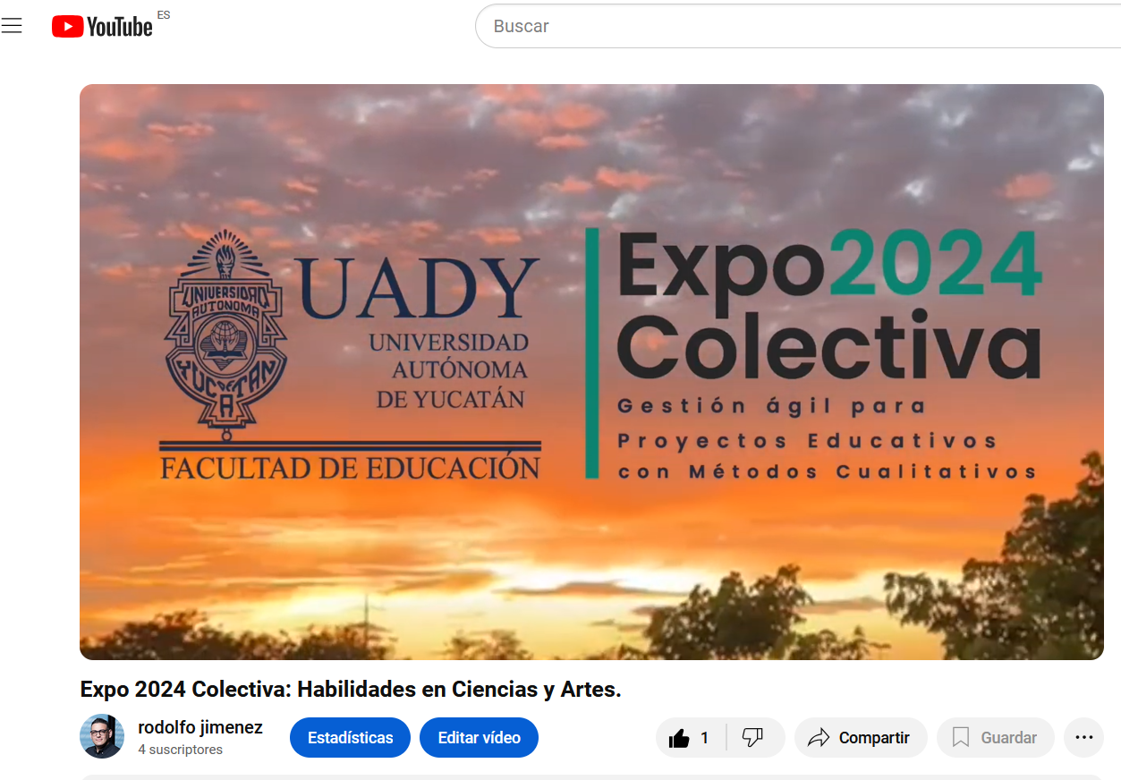
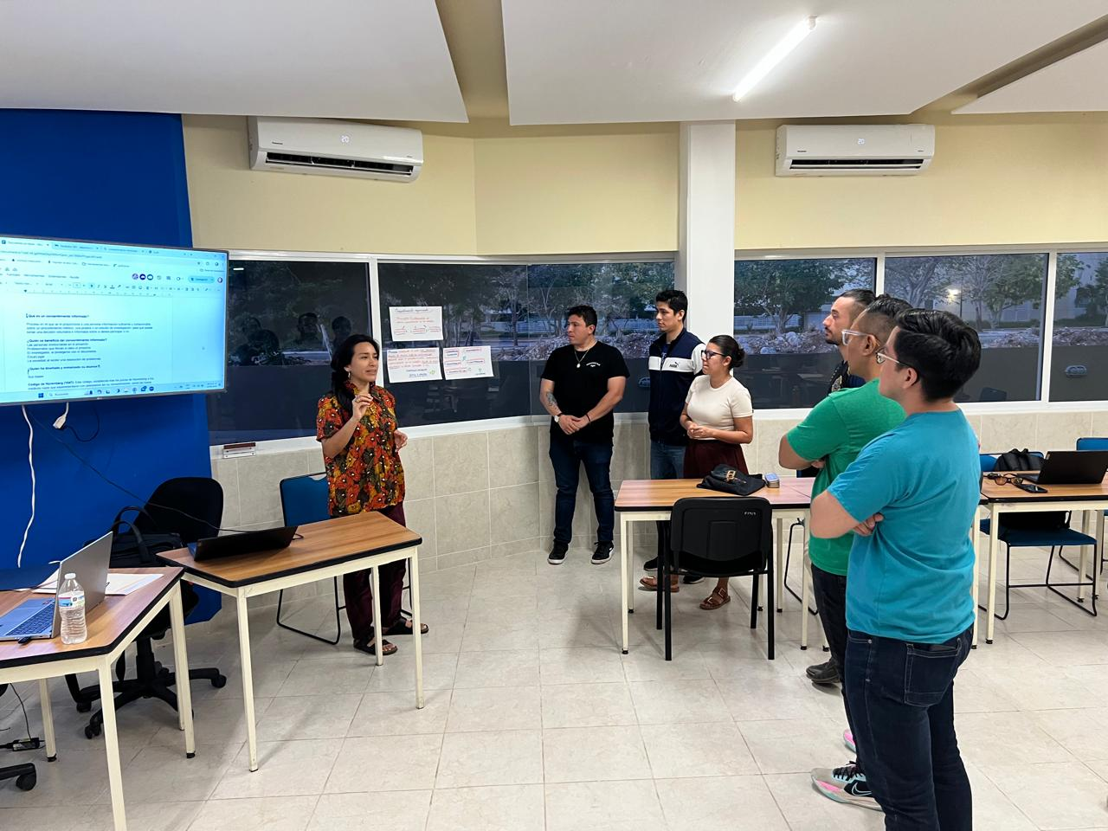
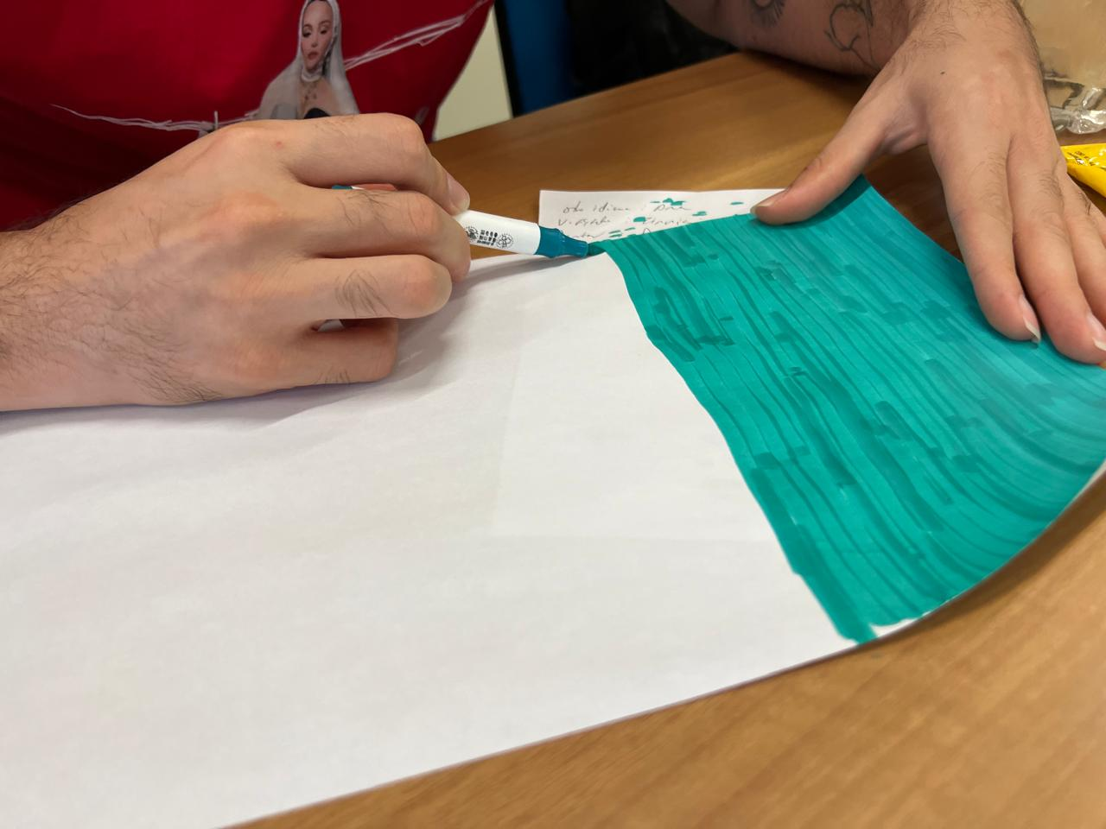
Training possibilities of participatory action research
Kemmis y McTaggart (2004, p. 595)
It generates critical attitudes and professional renewal.
It promotes change and transformation of action.
It involves participation and modification of the environment.
It strengthens the awareness of the subjects in the social process.
It urges the subjects to participate in social development.
VOCATIONAL TRAINING
SOCIAL PARTICIPATION
FORMATIVE ASPECTS
COGNITIVE ASPECTS
Transformation of attitudes and behaviors.
Active learning, construction of knowledge.
Enables personal development.
Acquisition of knowledge.
Acquisition of intellectual skills.
Development of observation and analysis skills.

Slide 9
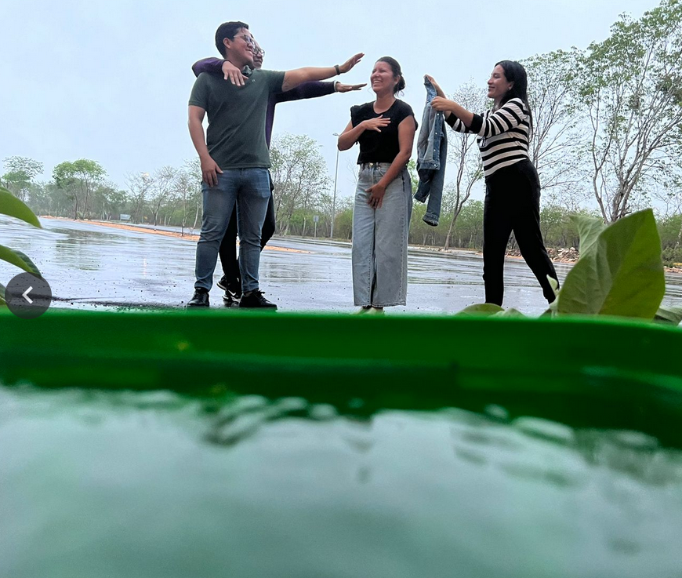
“There are learning climates free of disruption, a clear set of instructional goals, and high teacher expectations of students” (Robinson et al., 2014, p. 16).
2
3
[2].- Jiménez-León, R. (2024). Educational intervention photography. Digital
[3].- Botticelli , S. (1482-1485). La Nascita di Venere. Galería Uffizi, Florence, Italy.

Slide 10
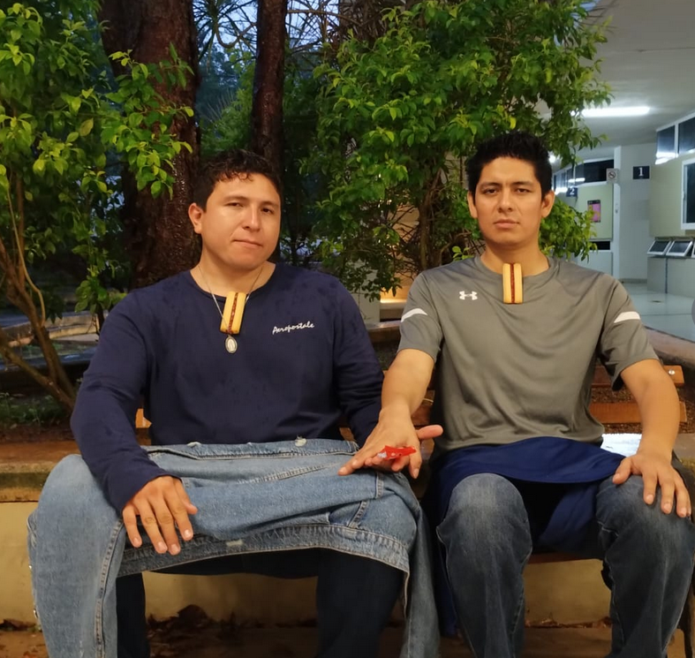
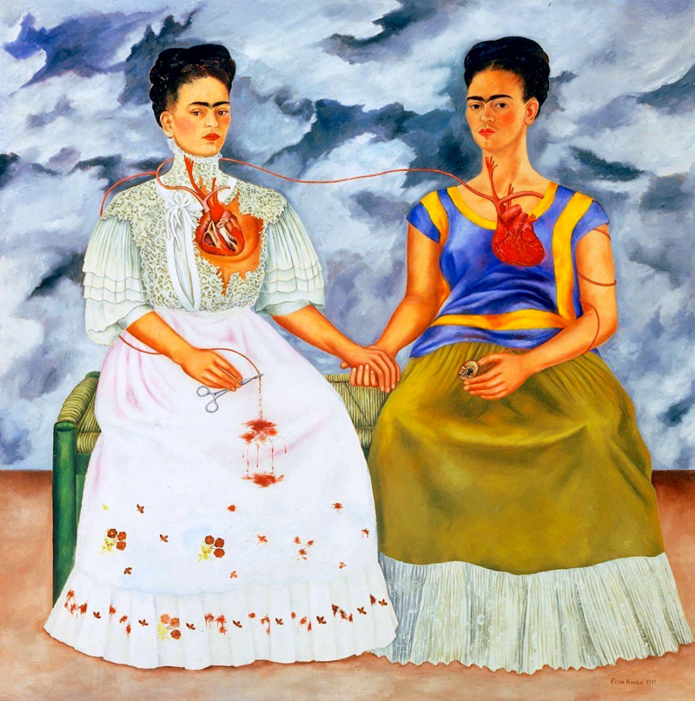
Ethics, autonomy, dignity, democracy, technology, information, communication, production of knowledge (research) and immaterial work through imagination are key categories from which the new realities of education and pedagogy are configured.
4
5
[4].- Jiménez-León, R. (2024). Educational intervention photography. Digital
[5.- Kahlo, F. (1939). The Two Fridas. Museum of Modern Art of Mexico, Mexico City. (Mexico, Oil (173.5 x 173 cm.)

Slide 11
Pedagogía crítica
Pedagogy, Education, Teaching and Learning are closely related. The educational project determines the pedagogical project.
The justification, the model of humanity and society that are embodied in an educational project, can make some pedagogies more relevant than others.
According to Foucault, cited by Bedoya and Gómez (1989), a teaching system is a ritualization of speech, a qualification and a fixation of the functions for the subjects of speech, the constitution of a doctrinal group and a distribution and an appropriation of the discourse with its powers and knowledge.
From education and pedagogy, it is necessary to ask the “what” (contents), the “how” (teaching methodologies), the “for what”, the “why”, the “who teaches”, “who learns”, “in what context” and “with what resources”.The answers to these questions become more relevant when research is assumed as the main pedagogical strategy.
Ethics, Autonomy, Dignity, democracy, technology, information, communication, production of knowledge (research) and immaterial work through imagination are key categories from which the new realities of education and pedagogy are configured.

Slide 12
Social function
Knowledge
Qualitative research methods
Skills
Processes of production and transfer of scientific knowledge
Sensitivity
Attitudes
Pedagogical leadership
Pedagogical transformation
Art-based research
problem solving
Educational management
Educational projects
Agile management for educational projects with qualitative methods
The intentionality of the teaching-learning process in the classroom at the higher leve
Factors associated with the lack of school initiative
Diagnosis of the school modality of engineering postgraduate courses at a private university in Yucatan from the students' perspective
Protocol of the professional training process in nutrition
Pedagogical foundations of playful group dynamics Gen z humor as a reflection for teaching social sciences
Impact of creative writing in the formation of an environmental awareness
Savoir fa ire: institutional tutoring towards teacher training in the French language

Slide 13
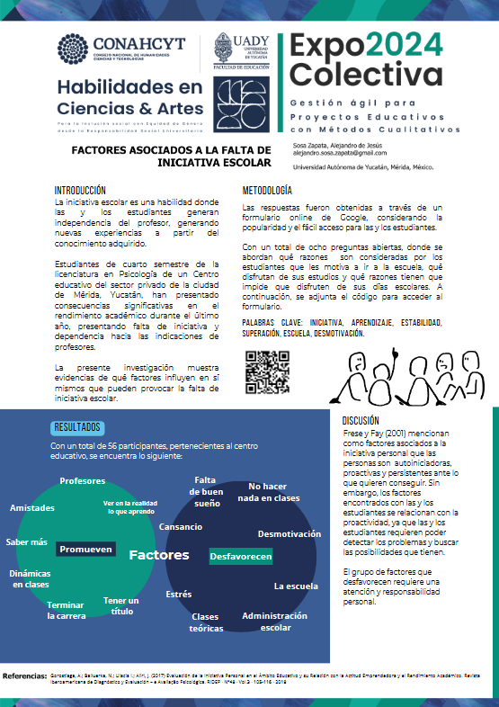
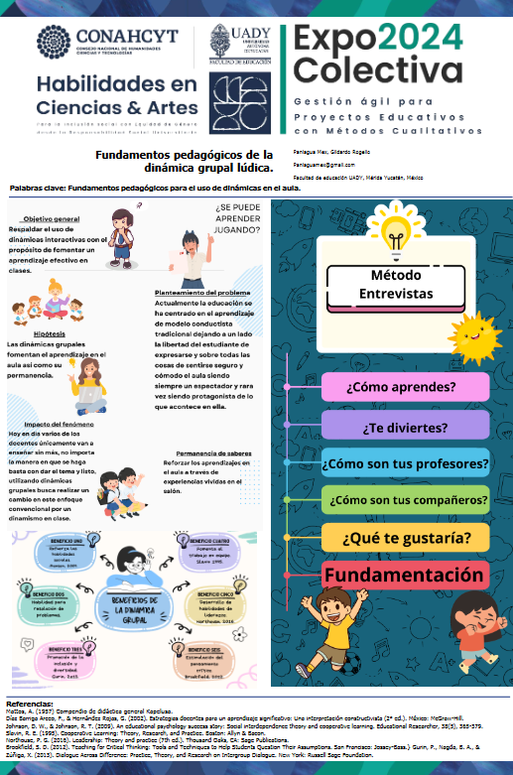
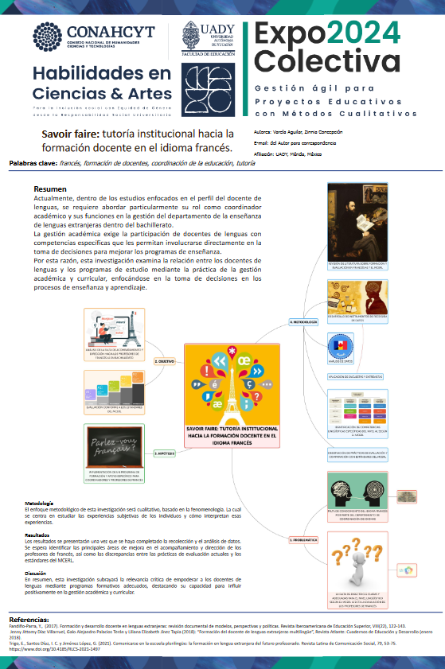
Motivation
Playful pedagogy
Interest in languages
6
7
8
[6].- Sosa-Zapata, A., F. (2024). Factors associated with the lack of school initiative [Scientific poster]. Agile Management in Educational Projects with Qualitative Methods.[7].- Paniaga-Max, G. (2024). Fundamentals of group dynamics. [Scientific poster]. Agile Management in Educational Projects with Qualitative Methods.[8].- Varela-Aguilar, Z. (2024). Institutional tutoring towards teacher training in the French language. [Scientific poster]. Agile Management in Educational Projects with Qualitative Methods.

Slide 14
Cooperative learning
Humanist paradigm: It places the student as the central axis of the learning process, highlighting their individuality.
Sociocultural paradigm: The subject's involvement in a certain social and cultural reality facilitates the acquisition of knowledge about it.
Constructivist paradigm: Students build and transform their own learning, the ability to learn to learn is emphasized.
Cooperative learning has traditionally been conceptualized as a teaching-learning method in which students assume the active and direct role in the construction of their own knowledge, through group work with their peers (Johnson, 1999).

Slide 15
Social utility model of knowledge for emerging university contexts
Social Utility of Knowledge
Utility and use of scientific and technological knowledge
Scientific advice
Interpretation models based on the existence of interactive processes
Intermediation
Social practices
Processes of production and transfer of scientific and technological knowledge
Social belonging
Science-society relationship
Dissemination of knowledge
Modes of dissemination of scientific knowledge
Flows of scientific and technological knowledge
Linking and transfer processes
Typology of knowledge exchange
Link between human action and knowledge
User
State
Symbolic capital
Mobilization of knowledge
Knowledge Transformers
Education Administration
Critical pedagogy
Educational management
School management
Emerging educational contexts
Pedagogical leadership
University Development
Digital competence
Academic capitalism
Cooperative learning
Assessment
Methodological innovation
Didactics
Communication
Investigation
Personal-attitudinal characteristics
Action and observation
Restructuring of the Plan
Reflection
Action and observation
Plan
9
[9].- Social utility model of knowledge for emerging university contexts.

Slide 16
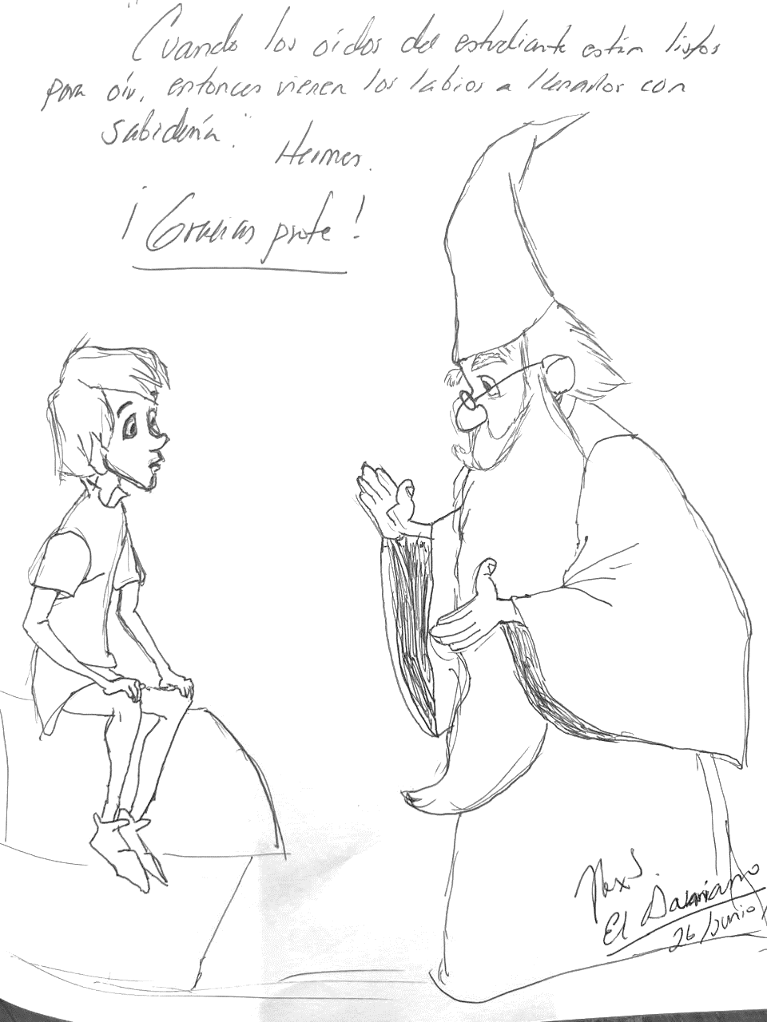
Logbook: Narrative 1
When the student's ears are ready to hear, then comes the lips to fill them with wisdom.
Thank you teacher!
10
[10].- Logbook for participant 01. Informed consent for the use of photographs, materials, etc. used in the subject.

Slide 17
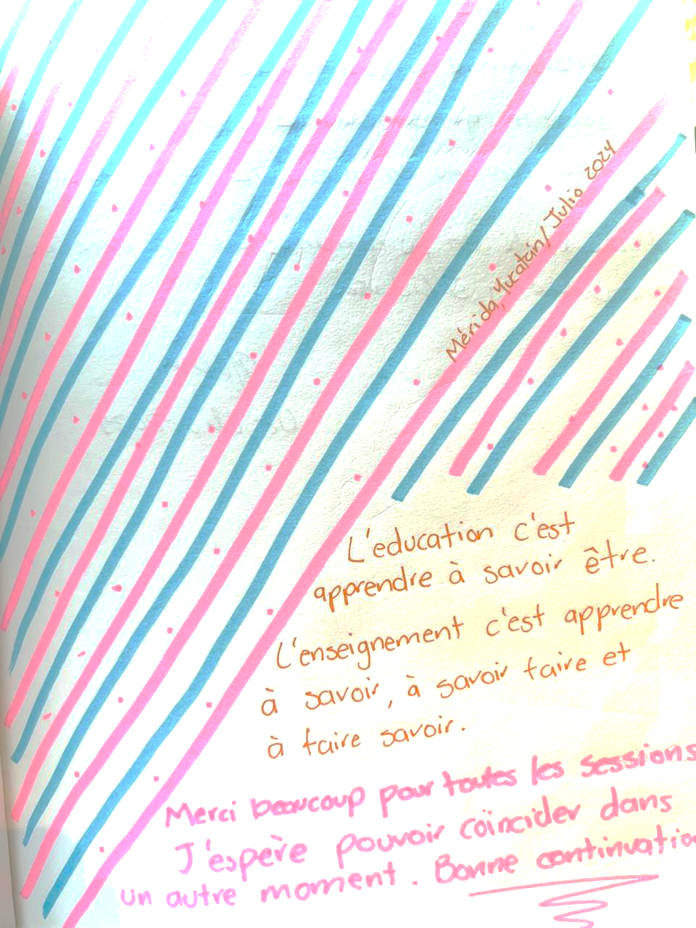
Logbook: Narrative 2
Education is learning to know how to be, teaching is learning to know how to do and how to tell, how to know.
Thank you very much for all the sessions,
I hope to be able to coincide at another time.
Good continuation.
11
[11].- Logbook for participant 02. Informed consent for the use of photographs, materials, etc. used in the subject.

Slide 18
Conclusions
The phenomenological movement has considered higher education as training, since it focuses on personal development rather than the possession of knowledge. This movement promotes research to find better ways of learning and living, confirming the importance of designing programs to generate social utility of knowledge through the solution of national problems.
In countries with low GDP levels such as Mexico, the current young population has the highest levels of education in the country's history and educational levels among young teachers have reached equal conditions, although the economic participation of women has not yet been achieved, it has increased substantially.
Therefore, the social utility of knowledge for social justice requires new teachers to raise the innovation economy and face the technological era. This can lead to a significant variation in teacher behavior, resulting in resistance to organizational change by HEIs.

Slide 19
References
Crowson, R. L. (1998). Community Empowerment and the Public Schools: Can Educational Professionalism Survive? Peabody Journal of Education, 73(1), 56–68. http://www.jstor.org/stable/1493287
Jiménez-León, R. & Cisneros-Chacón, E. J. (2023). Expo 2024 colectiva: Gestión ágil para proyectos educativos con métodos cualitativos. Universidad Autónoma de Yucatán.
Johnson, D. (1999). Making cooperative work. Theory in Practice, 38(2), 116-119. http://proiac.sites.uff.br/wp-content/uploads/sites/433/2018/08/cooperative_learning_johnsonjohnson1999.pdf
Kemmis, S. & Mctaggart, R. (1988). Cómo planificar la investigación-acción. Laertes.
Vaccarezza, L., S., & Zabala, J., P. (2002). La construcción de la utilidad social de la ciencia - Investigadores en biotecnología frente al mercado. Universidad Nacional de Quilmes. http://ridaa.unq.edu.ar/handle/20.500.11807/3004

Slide 20
Thank you for your attention. @boozrolf
rjimenezleon@ugr.es
rodolfo.jimenez@ujat.mx
rodolfo.jimenez@correo.uady.mx
The social utility of naturalistic knowledge from action-research for social impact in Latin America © Year 2024 by is under license CC BY-NC 4.0
Mobility Scholarship Program: CUMex – AUIP 2024

